Slide 1
EE603A Course Project
SOUND EVENT DETECTION
Name : Pratikhya Ranjit
Roll Number : 190639
Name : Rishabh Katiyar
Roll Number : 190702

Slide 2
Introduction
The Course Project deals with Audio Event Detection
Labelling the audio as speech, music or speech + music
The start and end time of audio segments

Slide 3
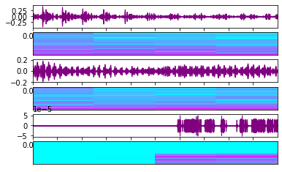
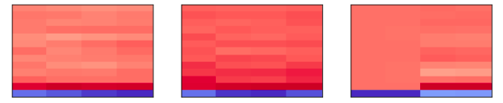
Dataset & Feature Extraction
3 types of sound clips namely music, speech & silence were prepared
Each sound clip was of 400s each
13 MFCC Coefficients for each sample were used as features
The First MFCC Coefficient of speech, music & silence
Waveplot & Spectrogram of Speech, Music, Silence( top to bottom)

Slide 4
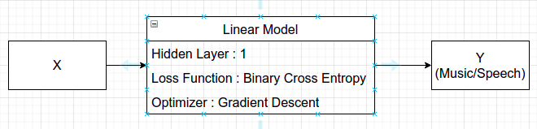
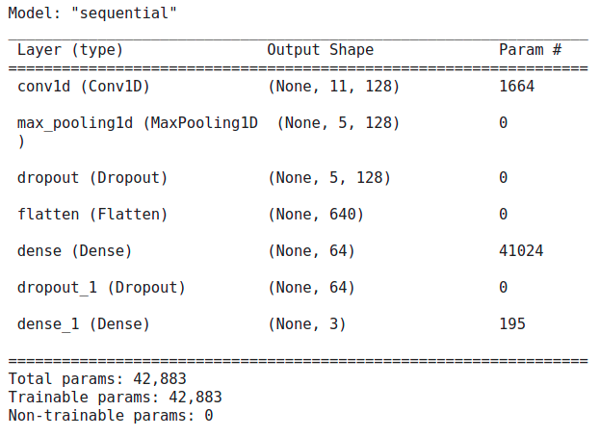
ML Based Models
Linear Classifier
CNN
Accuracy : 100% (on true labels)
Accuracy : 92.46 %

Slide 5
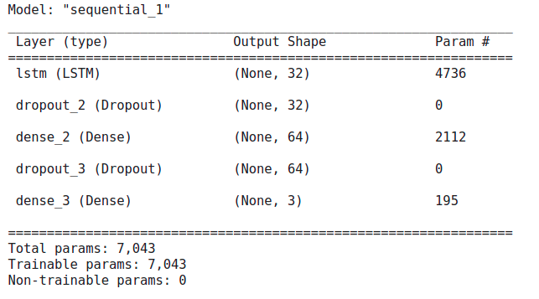
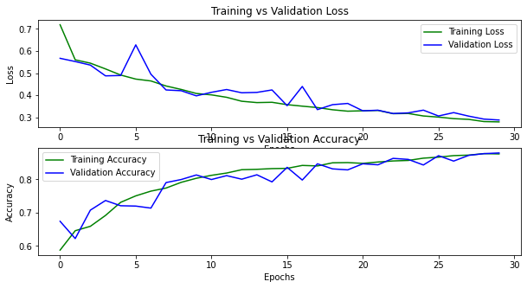
RNN
Accuracy & Loss vs Epochs
Accuracy : 87.76%

Slide 6
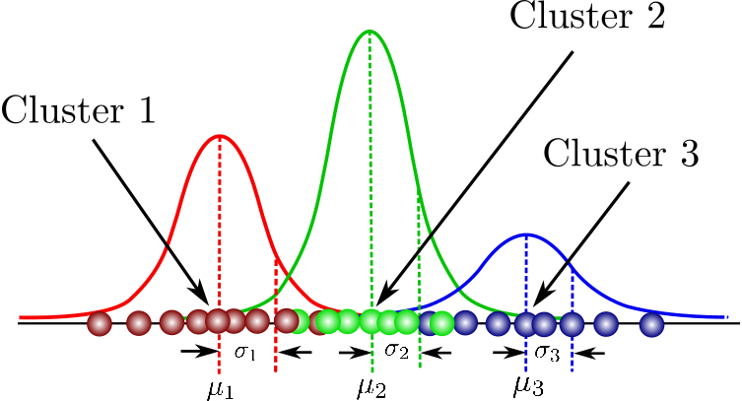
Probabilistic Models
GMM
2 GMM for Speech and Music classification
Trained GMM using EM Algorithm
Predicted likelihood of audio sample with each GMM to get final labels
Cluster2
Cluster1
Cluster3
Accuracy achieved with GMM was approx. 60%

Slide 7
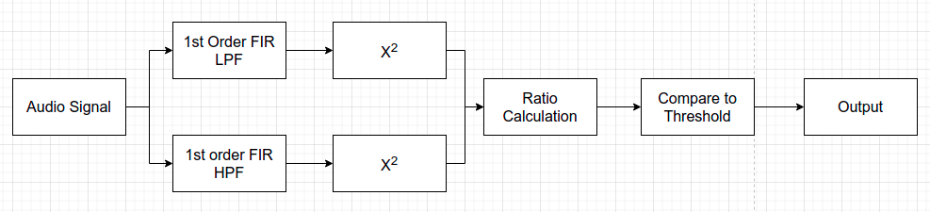
Digital Signal Processing Based Method
Cutoff frequency - 20KHz
Ratio Threshold - 10
Accuracy - 55%

Slide 8
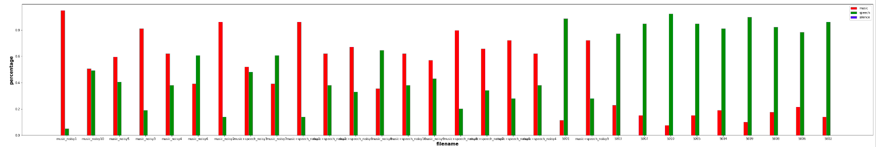
Audio Event Detection
Labelled each time frame as Music,Speech or Silence with CNN model
Combined similar frames together to get times of final event detection
Took the difference of music and speech likelihoods to classify them as only music, only speech or speech + music

